Slide 1
DATA ANALYTICS CASE STUDY
QuickBite Express
Business Recovery Analysis
A SQL-driven investigation into an 8-month order collapse, cancellation surge, and revenue crisis — and what the data reveals about the road to recovery.
144K+
70%
9
10
Orders Analyzed
Peak Order Decline
Months of Data
Business Questions
Prepared by Yashraj Sharma | AlphaAnalytics

Slide 2




Objective & Business Context
QuickBite Express is a food-delivery platform that experienced a sharp, unexplained decline in orders, ratings, and revenue over a nine-month window.
This project uses SQL as the primary analysis engine — from raw data modeling through referential-integrity checks to the final business insights — to diagnose exactly what happened, when, where, and to whom.
The goal: turn the Codebasics Business Recovery challenge dataset into a decision-ready story for leadership.
Clean, validated data model across 7 fact/dimension tables
10 primary business questions answered end-to-end in SQL
Actionable recommendations grounded in the numbers
02

Slide 3


Data Foundation & Methodology
Referential Integrity
Schema Cleanup
Validated foreign-key relationships across Orders, Customers, Restaurants, and Delivery Partners — orphan records were identified and removed before analysis.
Standardized ID data types and renamed fact/dimension tables (e.g. FACT_ORDERS → ORDERS) across 7 tables for a clean, query-ready model.
Customer Segmentation
Consistent Phase Definition
Every customer was tagged Pre-Crisis, Crisis, or Recovery based on signup date, enabling cohort-level comparisons throughout.
Pre-Crisis (Jan–May 2025) vs. Crisis (Jun–Sep 2025) windows were applied uniformly across all 10 business questions.
03

Slide 4
The Business Timeline
PRE-CRISIS
CRISIS
Jan – May 2025
Jun – Sep 2025
Stable ordering volume, healthy ratings, normal cancellation levels.
Orders collapse, cancellations spike, SLA breaks down, ratings crash.
Every metric in this deck is compared across these two anchor windows — Pre-Crisis vs. Crisis — to isolate the true impact of whatever went wrong in June 2025.
04

Slide 5

Order Volume Collapse
–70%
drop in total orders during the crisis period
No restaurant ever reached scale
Even before the crisis, no single restaurant crossed 50 pre-crisis orders — the busiest managed only 20. Order volume was spread thin across the platform, not concentrated in a few hubs, so the collapse can't be pinned on any one restaurant relationship.
05

Slide 6

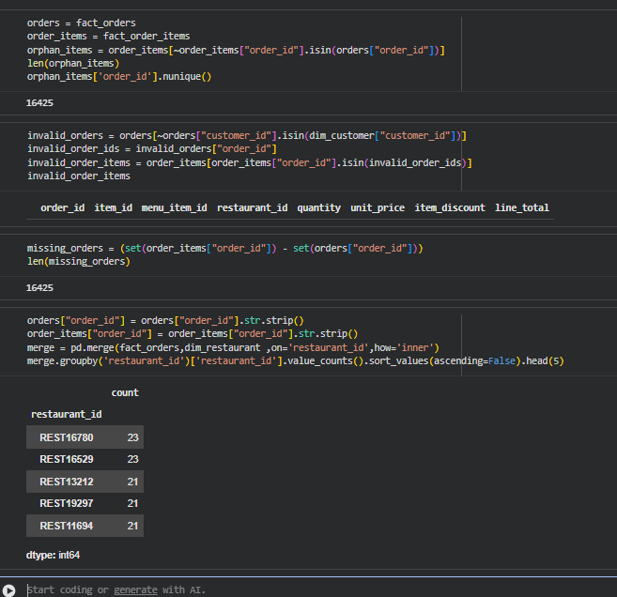
Cross-Checking the Q3 Finding in Python
The SQL finding in Q3 relies on the cleaned, referentially-validated tables built during data modeling. To make sure that finding wasn't an artifact of those cleanup choices, the same check was re-run independently in Python — directly on the raw fact_orders / fact_order_items tables, before any modeling.
16,425
orphan order_items rows (no matching order_id) — left in, not dropped
Included
orders from customers missing in dim_customer — left in, not dropped
23 orders
the busiest restaurant platform-wide, even on this unfiltered data
Even in the messiest, unvalidated version of the data, no restaurant comes close to the 50-order threshold used in Q3 — confirming the result independently of any SQL data-cleaning decisions.
pandas cross-check on the raw fact tables — no SQL modeling or cleanup applied
06

Slide 7

Hardest-Hit Cities
~70%
decline in every top-5 city
The decline was remarkably uniform across Bengaluru, Mumbai, Ahmedabad, Delhi, and Pune — all clustering within a single percentage point of each other.
This points to a platform-wide operational failure — not a regional or city-specific issue.
06

Slide 8

Cancellations Nearly Doubled
~2x
higher cancellation rate in crisis
Every one of the 8 cities in the dataset saw cancellations roughly double — from ~3.0–3.7% pre-crisis to ~6.3–7.2% during the crisis.
Bengaluru and Kolkata were hit hardest; Ahmedabad and Pune fared relatively “best” — but no city was spared.
07

Slide 9

Delivery Promises Broke Down
8.7x
-31.3 pts
60.1 min
increase in average delivery delay
(2.0 min → 17.6 min)
drop in SLA compliance
(43.6% → 12.3%)
average actual delivery time in crisis
(vs. 42.5 min expected)
Delivery times stretched past their own promised windows — the gap between actual and expected time widened dramatically, driving both the cancellation surge and the ratings collapse that follow.
08

Slide 10

Ratings Collapsed, Reviews Turned Negative
Customers said, in their own words:
“Stale food served”
“Very late”
“Bad taste”
“Packaging issue”
Ratings fell from the mid-4s to the low-2s the moment the crisis began — and stayed there for all four crisis months, with delivery-delay and food-quality complaints replacing routine feedback.
09

Slide 11

Revenue Impact
₹2.67 Cr
estimated revenue lost during the crisis window
–70.9%
revenue decline vs. the pre-crisis run-rate
Estimated using the pre-crisis revenue run-rate (subtotal + delivery fee − discounts) as the benchmark against actual crisis-period revenue.
10

Slide 12

Loyalty Wasn't Enough
58
49 (84%)
30 of 58
customers had placed
5+ orders pre-crisis
of those loyal customers
stopped ordering in the crisis
had rated QuickBite
4.5+ before the crisis
Satisfaction didn't prevent churn
Most of the customers who churned were already loyal and satisfied — 30 of the 58 had rated the service 4.5 or higher before the crisis. Their departure wasn't about product fit or preference; it tracks directly with the operational failures seen in delivery SLA and cancellations. Winning them back is an operations fix, not a marketing one.
11

Slide 13

Top Spenders Vanished Too
Among the top 5% of customers by pre-crisis spend, the pattern was near-universal collapse — not a gradual pullback:
Customer | City | Cuisine Pref. | Spend (Pre-Crisis) | Spend (Crisis) | Monthly Freq. Drop
CUST179266 | Delhi | Pizza | ₹2,404.06 | ₹0.00 | 1.20 → 0.00
CUST125990 | Chennai | Biryani | ₹2,403.16 | ₹0.00 | 1.00 → 0.00
CUST163628 | Chennai | South Indian | ₹2,397.58 | ₹0.00 | 1.00 → 0.00
CUST165515 | Pune | Pizza | ₹2,349.96 | ₹0.00 | 1.00 → 0.00
CUST041121 | Bengaluru | Healthy | ₹2,188.43 | ₹0.00 | 1.20 → 0.00
The drop-to-zero pattern shows up across every city and every cuisine preference — confirming, at the individual customer level, what the city and revenue data already show: this was a platform-wide breakdown, not a niche or segment-specific problem.
12

Slide 14
Key Recommendations
1
Fix delivery capacity first
SLA compliance (43.6% → 12.3%) is the common root cause behind the cancellation surge, the rating collapse, and much of the churn. Operational fixes will move more metrics than any marketing spend.
2
Launch a targeted win-back campaign
Prioritize the 49 loyal, previously-satisfied customers who stopped ordering — they liked the product before things broke, so a service-recovery outreach is likely to land well.
3
Investigate food-quality & safety flags
Reviews mentioning stale or cold food and food-safety concerns spiked during the crisis — these need restaurant-level follow-up, not just a delivery-time fix.
4
Treat this as platform-wide, not regional
Because the decline was near-identical across all top cities and cuisines, fixes should be rolled out platform-wide rather than piloted city-by-city.
13

Slide 15




Thank You
QuickBite Express — Business Recovery Analysis
yashrajsh1234@gmail.com
github.com/yashraj-DS
linkedin.com/in/yashraj-sharma-4a87ab348
https://yashraj-ds.github.io/yashraj_portfolio/
Yashraj Sharma

